Slide 1
Project 3: Validation of Confidence Intervals
November 18, 2024
Image Adhikari, Patrick Philippy
CISC-820
Quantitative Foundations

Slide 2
Datasets
Several distributions were sampled in order to evaluate the 10 confidence intervals given.
Bernoulli Distributions with 𝑝∈{0.01, 0.5, 0.99}
Uniform Distributions on the intervals [0.0, 1.0]; [0, 0.3]; [0.3, 0.7]; and [0.7, 1.0]
“Noisy” Distribution consisting of 1,000,000 values in the interval [0.0, 1.0] pre-sampled from a 0, 1 Gaussian distribution.
These datasets were chosen as they have diverse means, skews, and standard deviations.
Notes:
Early on, we were testing only distributions with high entropy and means near 0.5, but most of the CIs capture these distributions’ means very well.
The noisy distribution turned out not to be very informative relative to the other distributions.
We tried to select both continuous and discrete distributions in order to rule that out as a confounding variable.
Another family of distributions we considered, but did not end up using are beta distributions.

Slide 3
CI Criteria
Exact: A CI is considered Exact if it captures a percentage of sample means greater than some 1-𝛼:
For all tested distributions
For all sample sizes, N
Asymptotic: A CI is considered Asymptotic if it captures a percentage of sample means greater than some 1-𝛼:
For all tested distributions
Invalid: A proposed CI is considered Invalid if it:
Has inconsistent 𝛼 with respect to N.
Often this means it fails to capture any sample means for some distributions.
Notes:
Initially we were assuming alpha had to be consistent across distributions, but we later refined our approach to simply require alpha as an upper bound.

Slide 4
Results
Appears to be Asymptotically Valid with an 𝛼 of 0.00.
For small sample sizes (i.e. 5-10) it is highly probable that the CI will not have enough information to be representative of the population.
This probability decreases to 0.00 with increased N.
For finite distributions like we are testing, 𝛼 is near-zero within N<100.
𝛼 = 0.00 is not informative. This CI is not very practical.
Invalid.
For distributions with sparse tails (e.g. <5% outliers), fails to capture mean consistently.
Missed the true mean 100% of the time for our Bernoulli with 𝑝∈{0.01, 0.99}.
Asymptotically Valid with 𝛼=0.05.
𝛼 approaches and oscillates around 0.05 with high N.
Behavior is consistent across distributions.
Invalid.
For distributions with means near 0 or 1, fails to capture the mean.
Missed the true mean 100% of the time for our Bernoulli with 𝑝∈{0.01, 0.99}.

Slide 5
Results
Appears to be Exactly Valid with an 𝛼 of 0.1.
𝛼 oscillates closely around 0.1, but does not appear to be strongly correlated with N.
Consistent for all distributions
Invalid.
For distributions with means near 0, fails to capture mean consistently.
Missed the true mean 100% of the time for our Bernoulli with 𝑝=0.01.
Exactly Valid.
𝛼 is 0 for most distributions.
For Bernoulli with 𝑝=0.5, 𝛼 is approximately 0.1.
Invalid.
For distributions with sparse tails (e.g. <5% outliers), fails to capture mean consistently.
Missed the true mean 100% of the time for our Bernoulli with 𝑝∈{0.01, 0.99}.

Slide 6
Results
Appears to be Asymptotically Valid with an 𝛼 of 0.01.
𝛼 oscillates closely around 0.01 for sufficiently high N.
Consistent for all distributions.
Notably, higher N is required for convergence with very skewed distributions.
Exactly Valid.
𝛼 is 0 for most distributions.
For Bernoulli with 𝑝=0.5, 𝛼 is approximately 0.05.

Slide 7
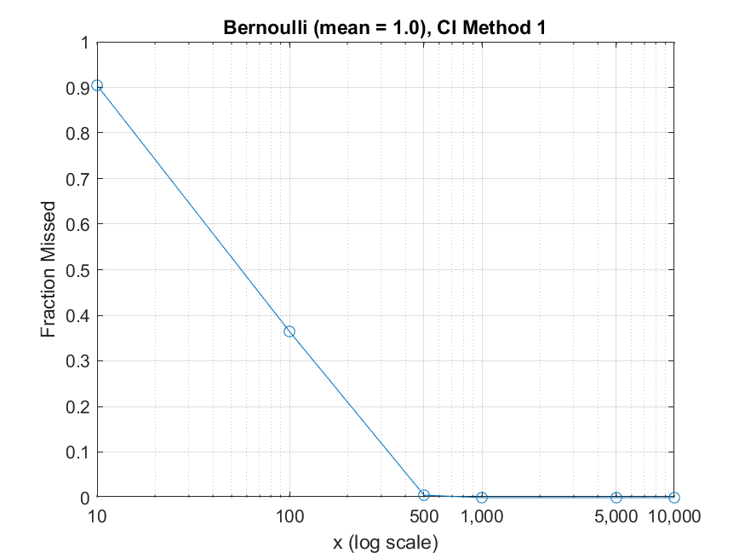
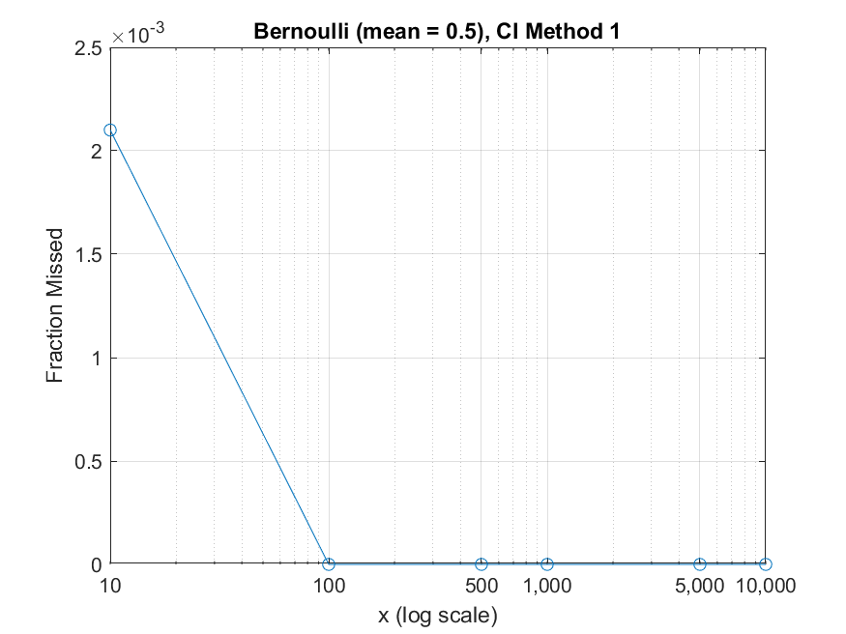
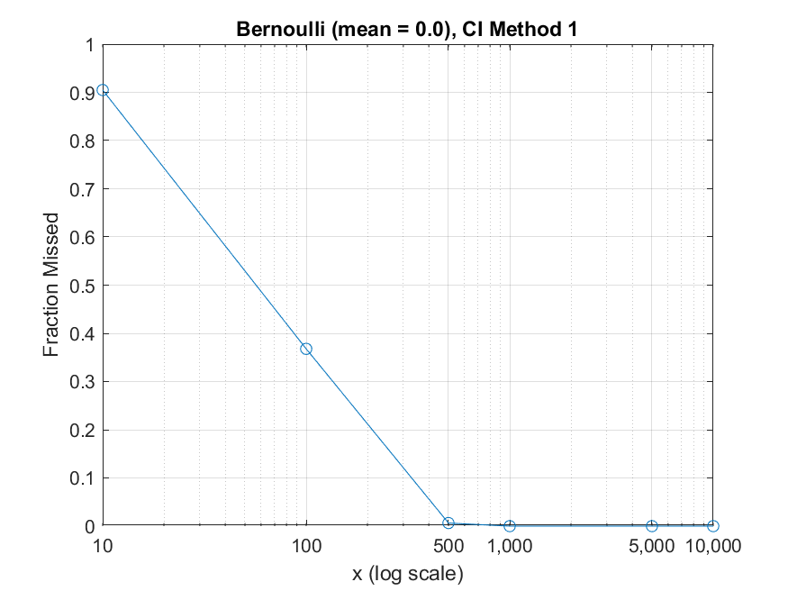
Bernoulli (mean = 0.99), CI Method 1
Bernoulli (mean = 0.5), CI Method 1
Bernoulli (mean = 0.01), CI Method 1
Asymptotic behaviour in CI method 1

Slide 8
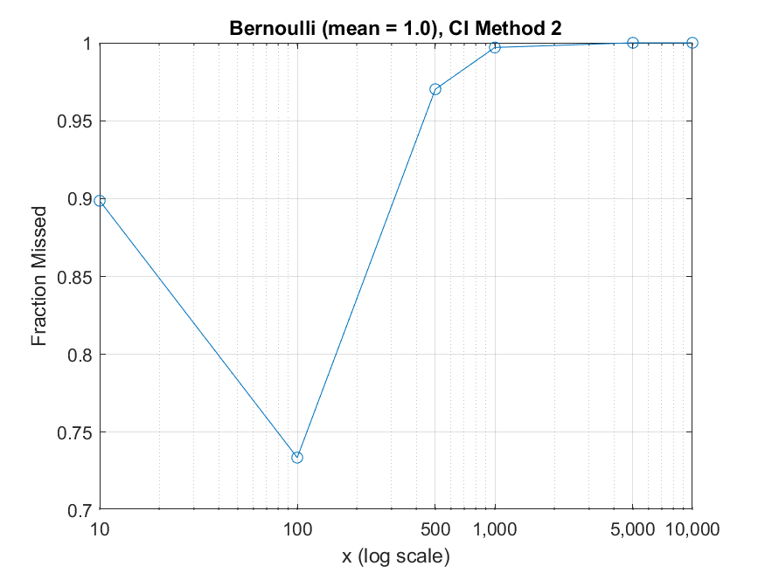
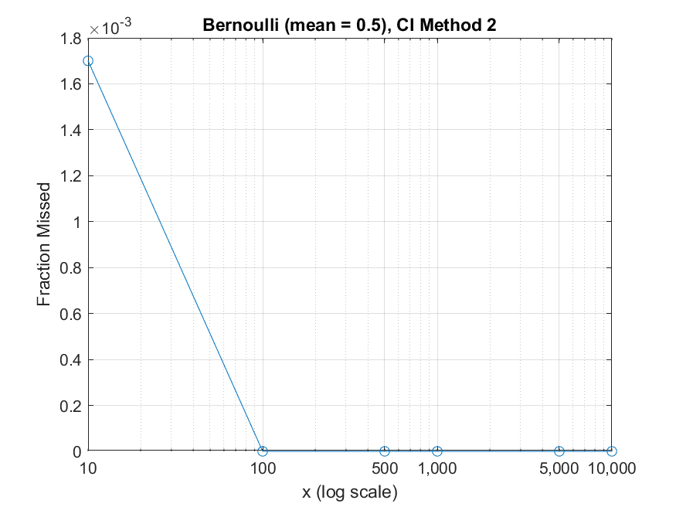
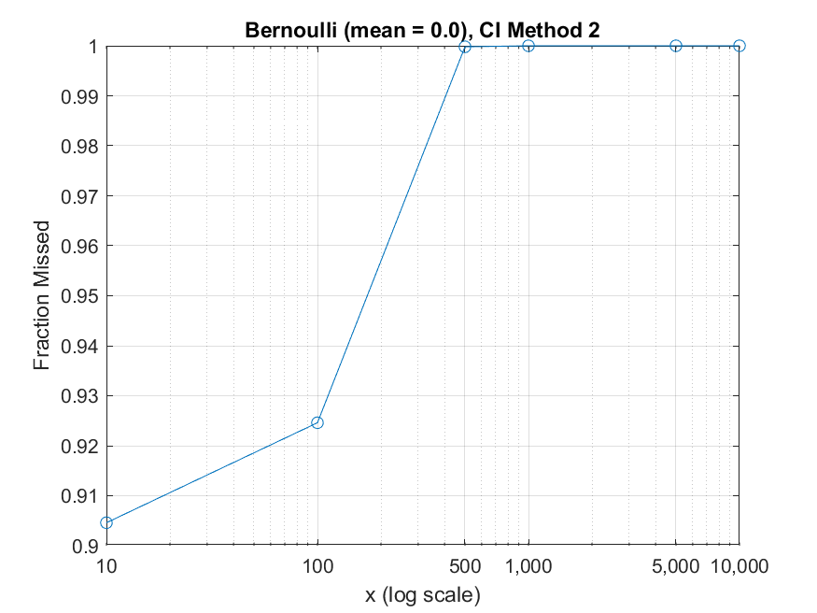
Bernoulli (mean = 0.99), CI Method 2
Bernoulli (mean = 0.5), CI Method 2
Bernoulli (mean = 0.01), CI Method 2
Invalid behaviour in CI method 2

Slide 9
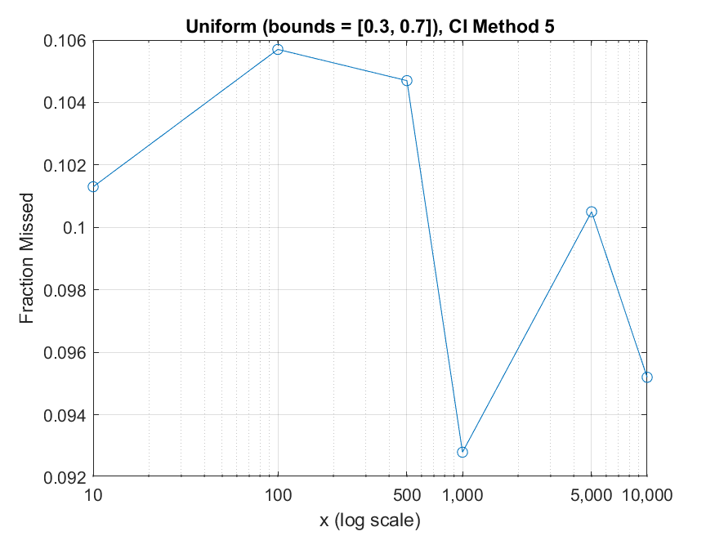
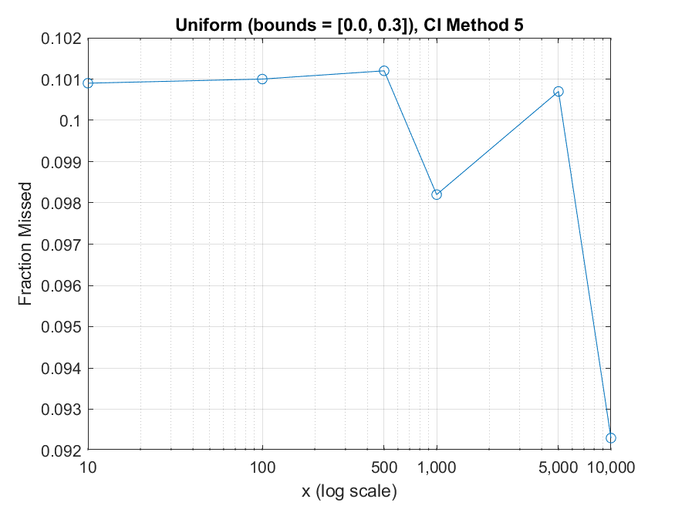
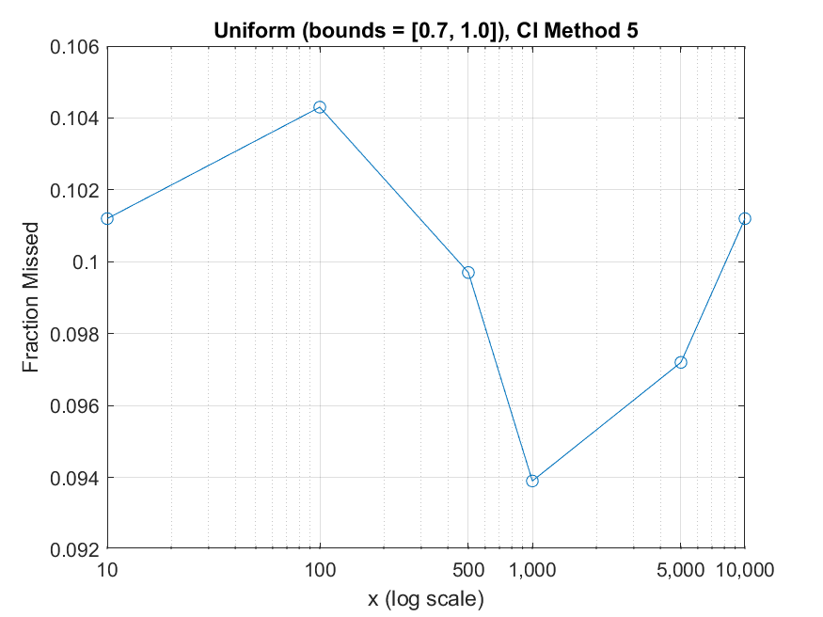
Valid(Exact) behaviour in CI method 5

Slide 10
Thank You

